Slide 1
Julius Caesar
True or False?

Slide 2
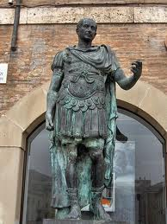
True or False?
In the beginning of the play,
Flavius and Marullus order
the commoners to disrobe
the statues of Caesar so he
will not become even more
popular.
False

Slide 3
True or False?
Flavius and Marullus are sentenced to die for their part in opposing Caesar.
True

Slide 4
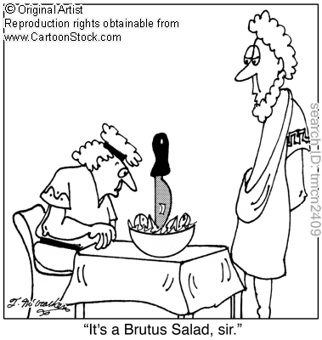
Caesar loved and trusted Brutus
True

Slide 5
Cassius wrote letters in different styles as if from citizens to
persuade Brutus to join the conspiracy.
True

Slide 6
Antony brought Caesar’s will to the funeral but chose not to read it.
False

Slide 7
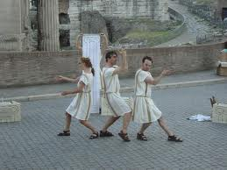
Marc Antony created a new triumvirate which included himself, Octavius Caesar and Lucius.
False
Lepidus

Slide 8
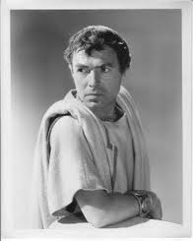
The definition of a tragic hero is: The tragic hero is not entirely good (in which he can do no wrong) but rather the hero commits a great wrong which leads to his misfortune.
True

