Slide 1
Julius Caesar
True or False?

Slide 2
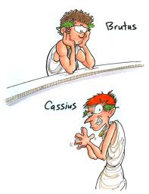
True or False?
Cassius influenced
Brutus to join the
conspiracy.
True

Slide 3
Cassius advised the conspirators to kill both Caesar AND Antony
True

Slide 4
Portia had a terrible dream and advised her husband not to go to the senate that day.
False (Calpurnia did)

Slide 5
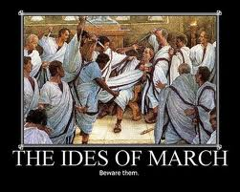
Besides Caesar,
the conspirators killed
between 70-100 senators
False. (The conspirators killed only Caesar)

Slide 6
Both Brutus and Antony addressed the commoners at Caesar’s funeral
True

Slide 7
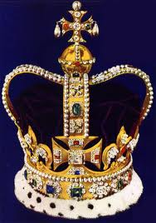
Cassius and Brutus saw
Caesar refuse the crown
three times
False (they heard about
It)

Slide 8
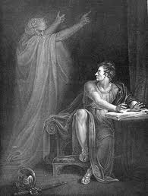
The ghost that appears in Brutus’s tent says it’s the evil spirit of Caesar.
False (evil spirit of Brutus)

Slide 9
Casca is the first of the conspirators to stab Caesar.
True

Slide 10
Fear of Caesar’s potential tyranny drives Brutus to join the conspiracy.
True

